Slide 1
CIS 4526 Foundations of Machine Learning
Chapter 8
Support Vector Machine
Some slides adapted from Dr. Wenpeng Yin Slides from previous semester at Temple University
https://www.youtube.com/watch?v=N1vOgolbjSc
https://www.youtube.com/watch?v=efR1C6CvhmE

Slide 2
Outline
Introduction
online videos/examples
Linear SVM
Maximum Margin
Hyperplane
Optimization
Linear SVM for Non-separable Data
Nonlinear SVM
Feature Expansion
What is Kernel
Kernel Tricks

Slide 3
Outline
Introduction
online videos/examples
Linear SVM
Maximum Margin
Hyperplane
Optimization
Linear SVM for Non-separable Data
Nonlinear SVM
Feature Expansion
What is Kernel
Kernel Tricks

Slide 4
Fun videos
Cupcake vs muffin
https://www.youtube.com/watch?v=N1vOgolbjSc
StatQuest on Mice being obese
https://www.youtube.com/watch?v=efR1C6CvhmE

Slide 5
Support Vector Machine
SVM is a supervised learning model for classification and regression analysis. When it is used for classification, it is called Support Vector Classifier.
The algorithm involves finding a hyper-plane in a higher dimensional space which can be used to separate the two different class for binary classification. That is it provides a decision boundary for classifying data points
The criteria for finding this hyperplane is based on the so-called “widest street approach” that has the largest margin: i.e., largest distance to the nearest training data points of any class

Slide 6
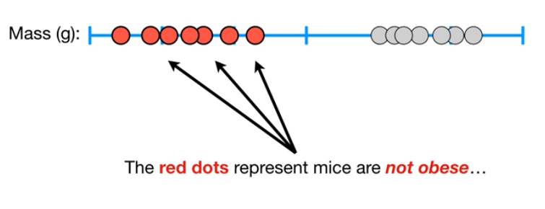
Maximum Margin Classifier in 1-dimension

Slide 7
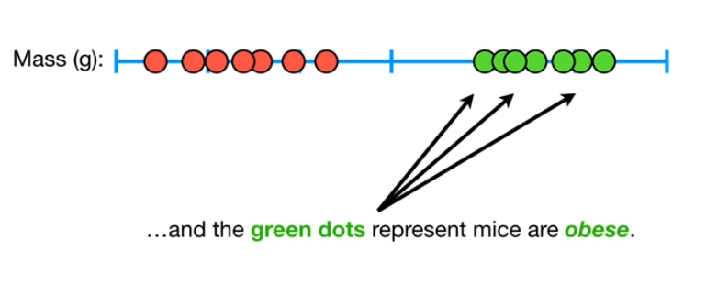
Maximum Margin Classifier in 1-dimension

Slide 8
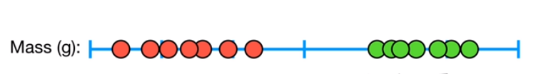
Maximum Margin Classifier in 1-dimension
How to choose the threshold to decide whether the Mice is obese

Slide 9
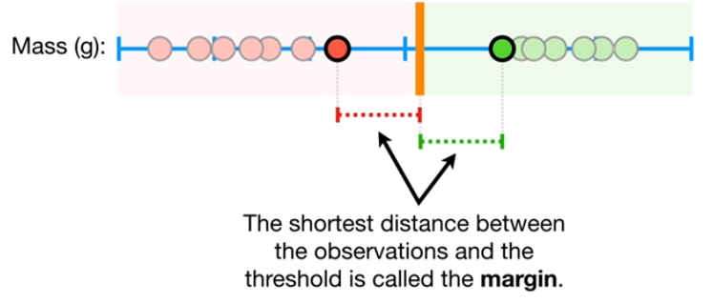
Maximum Margin Classifier in 1-dimension

Slide 10
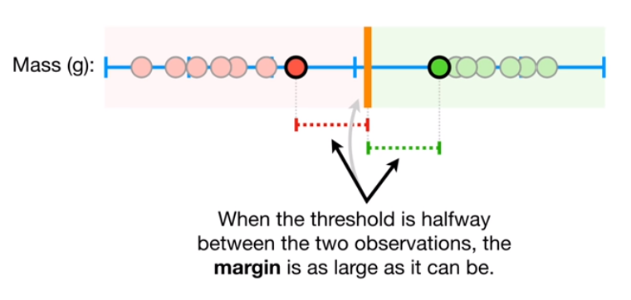
Maximum Margin Classifier in 1-dimension

Slide 11
Outline
Introduction
online videos/examples
Linear SVM
Maximum Margin
Hyperplane
Optimization
Linear SVM for Non-separable Data
Nonlinear SVM
Feature Expansion
What is Kernel
Kernel Tricks

Slide 12
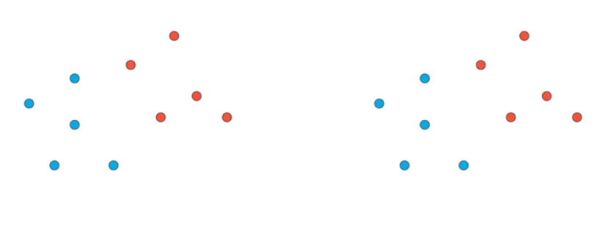
Maximum Margin Classifier in 2-dimension
Draw a line that can separate the blue and red dots. The line will
serve as the decision boundary.
X2
X2
X1
X1

Slide 13
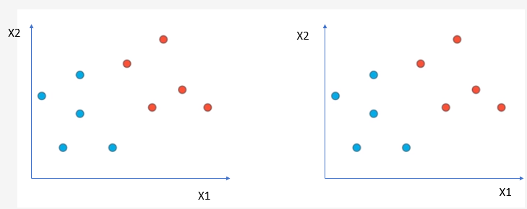
Maximum Margin Classifier in 2-dimension
Which line will be a better line?

Slide 14
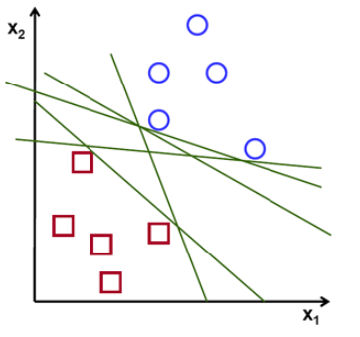
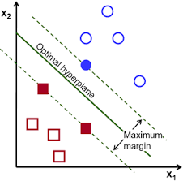
Maximum Margin Classifier in 2-dimension
Which of the lines separate the blue circle from the red square data points?

Slide 15



Maximum Margin Classifier in 2-dimension

Slide 16


Maximum Margin Classifier in 2-dimension

Slide 17

Maximum Margin Classifier in 2-dimension
We want to construct a “street”
❏ with a maximum width
❏ without touching the buildings

Slide 18
Maximum Margin Classifier in 2-dimension
Once we build such a “street”, the perfect hyperplane would be the middle line

Slide 19
Maximum Margin Classifier in 2-dimension
The maximum margin linear classifier is the linear classifier with the maximum margin.
This is the simplest kind of SVM (called Linear SVM)

Slide 20

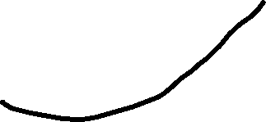



Maximum Margin Classifier in 2-dimension
Support Vectors
On the edge of the best “street”

Slide 21
Why Maximum Margin?
❏ Intuitively this feels safest. If we’ve made a small error in the location of the boundary, this gives us least chance of causing a misclassification.
❏ The model is robust since it is immune to removal of any non-support-vector datapoints.
❏ Empirically it works very very well.

Slide 22
Short summary
In Linear Regression, we use Least Square Method. We minimize the Mean Square Error
In Logistic Regression, we use Maximum Likelihood Principle
In SVM, we use Maximum Width Approach
Which is to find the hyperplane that maximize the margin between the plane and its nearest data points which are called the support vectors.
Related terminology that we need to understand in the following slides
Hyperplane
Maximum Margin Classifier
Margin, Soft Margin
Support Vectors
C – parameters
Kernel tricks

Slide 23
What is Hyperplane
A hyperplane in p dimensions is a flat affine subspace of dimension p-1.
In general, the equation for a hyperplane has the form
β₀+β₁X₁+β₂X₂+...+β_{p}X_{p}=0
In p = 2 dimensions a hyperplane is a line, In p =3 dimensions a hyperplane will be a 2-dim plane
If β₀ = 0, the hyperplane goes through the origin, otherwise not.
The vector β = (β₁, β₂, · · · , β_{p}) is called the normal vector — it points in a direction orthogonal to the surface of a hyperplane.

Slide 24
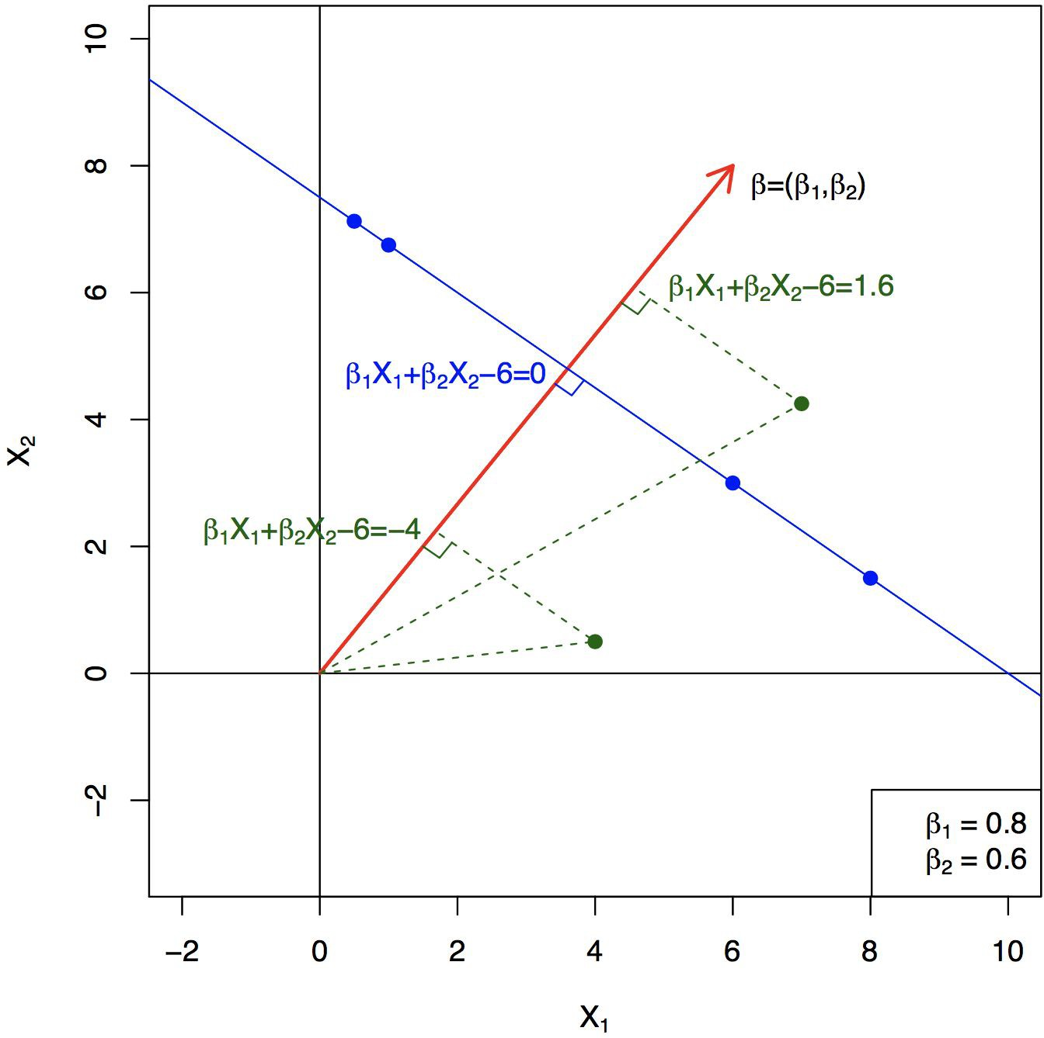

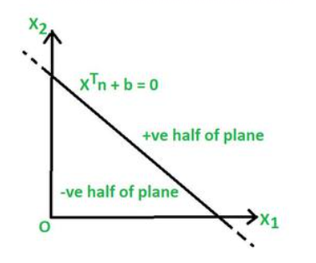
Hyperplane in 2 Dimensions
Hyperplane, Subspace and Halfspace - GeeksforGeeks

Slide 25
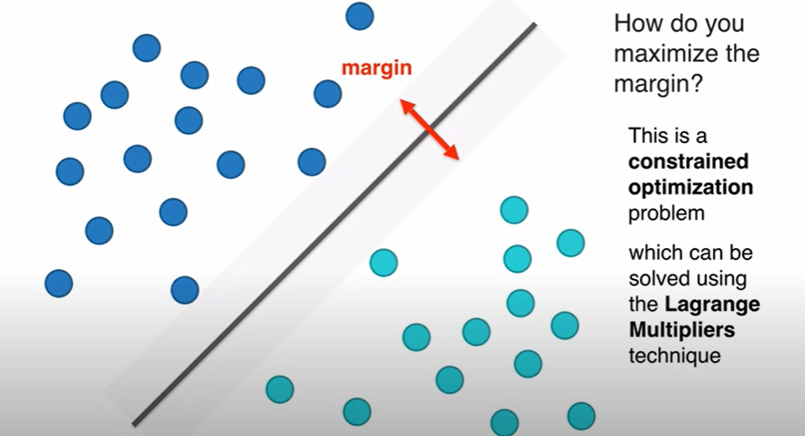
How to solve the Maximum width problem

Slide 26
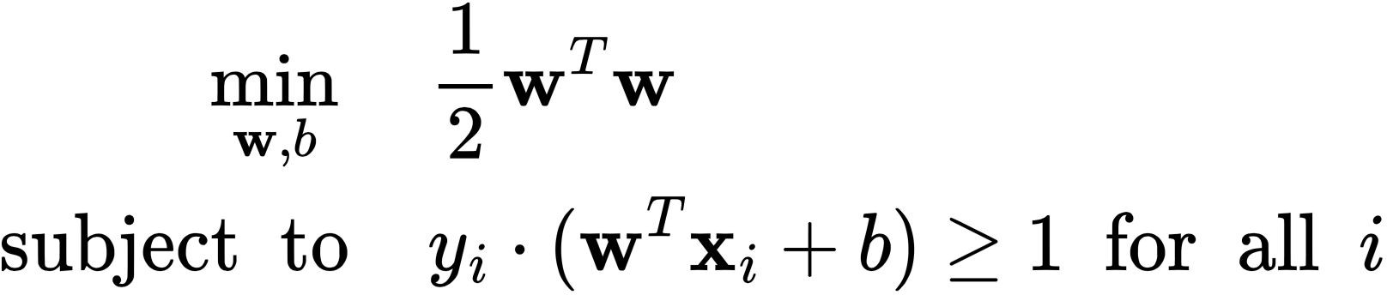


How to find the optimal Hyperplane
Linear classifier: f(x)=wx+b
The optimal hyperplane is a solution of the following constrained optimization problem:
See Appendix A

Slide 27
Outline
Introduction
online videos/examples
Linear SVM
Maximum Margin
Hyperplane
Optimization
Linear SVM for Non-separable Data
Nonlinear SVM
Feature Expansion
What is Kernel
Kernel Tricks

Slide 28
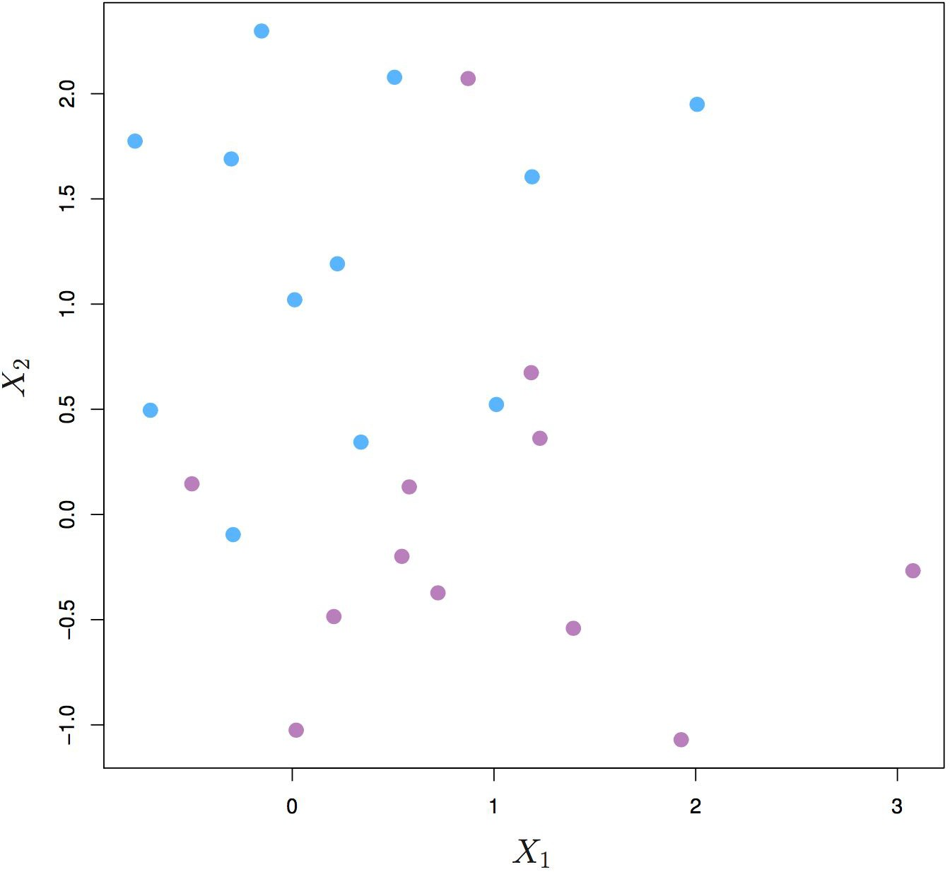
Linear SVM for Non-separable Data
The data on the left are not separable by a linear boundary.

Slide 29
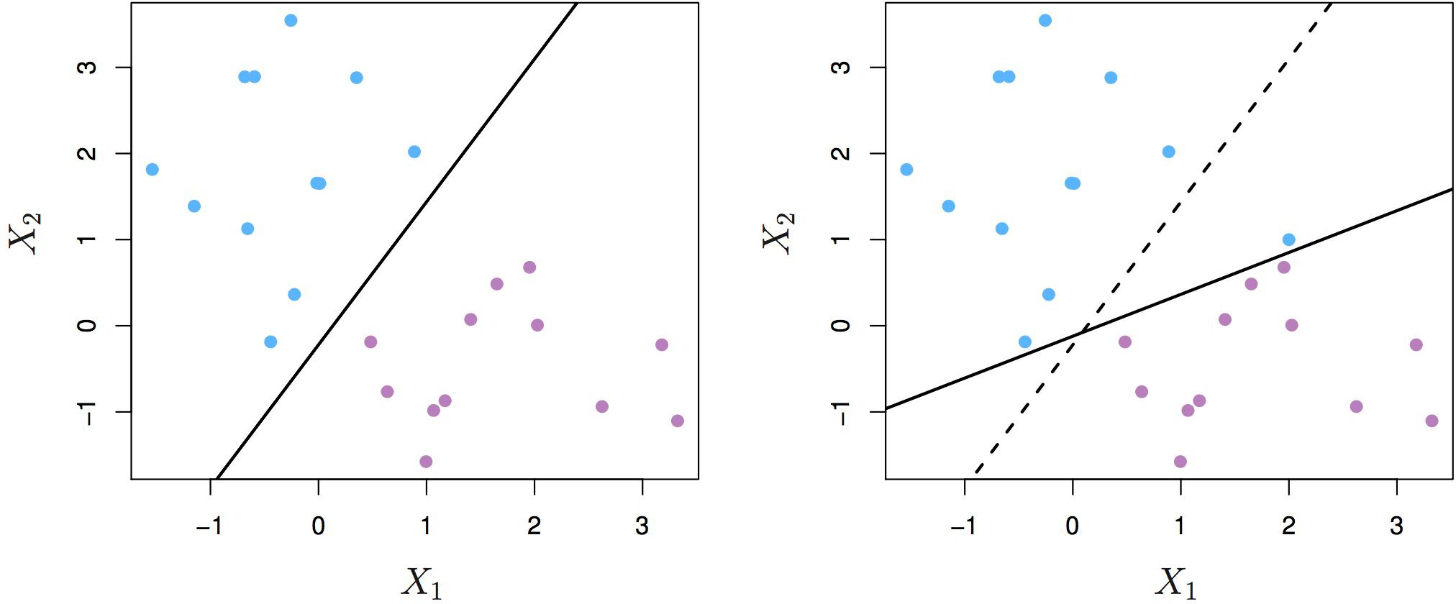
Linear SVM for Non-separable Data
❏ Sometimes the data are separable, but noisy. This can lead to a poor solution for the maximal-margin classifier.
❏ The SVM maximizes a soft margin.

Slide 30
Concepts of Hard vs Soft Margin
Hard Margin: No misclassification
Soft Margin: Allow misclassification
Introduce a model parameter, called C-Parameter
This is the first so-called hyperparameter, parameters that can change, dial, fine-tune how a model behaves.
Hyperparameter is NOT the model coefficients which are the output of an optimization engine to try to find the best-fitted lines
The idea of C-Parameter is to suggest how much the model is allowed to mis-classify some of the data points so that it has a higher chance of generalizing to out-of-sample data set (our old friend bias-verus-variance trade-off issue)

Slide 31
Concepts of Hard vs Soft Margin
C-Parameter
Default value is 1, but can be changed inside the SVM call
Low C-Parameter
allows mis-classification
Soft margin
Less complicated model, high bias, low variance, may underfit
High C-Parameter value
Try to fit as much as possible, allows no mis-classification
Hard margin
More complicated model, low bias, high variance, may overfit

Slide 32
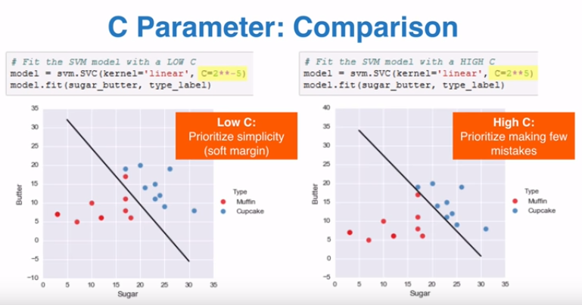
Examples

Slide 33
Support Vector Machine
Learning by doing

Slide 34
Outline
Introduction
online videos/examples
Linear SVM
Maximum Margin
Hyperplane
Optimization
Linear SVM for Non-separable Data
Nonlinear SVM
Feature Expansion
What is Kernel
Kernel Tricks

Slide 35
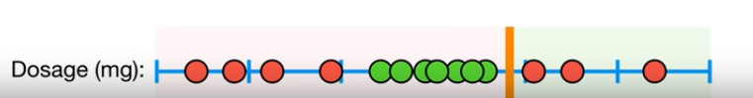
Nonlinear SVM:
Sometime a linear boundary simply won’t work, no matter what value of C
Example (1-D) Drug Dosage
Green dots are the cured patients while the red dots are patients with incorrect dosage and so not cured
One cannot choose a decision boundary (the yellow line) to separate the two set of sets

Slide 36
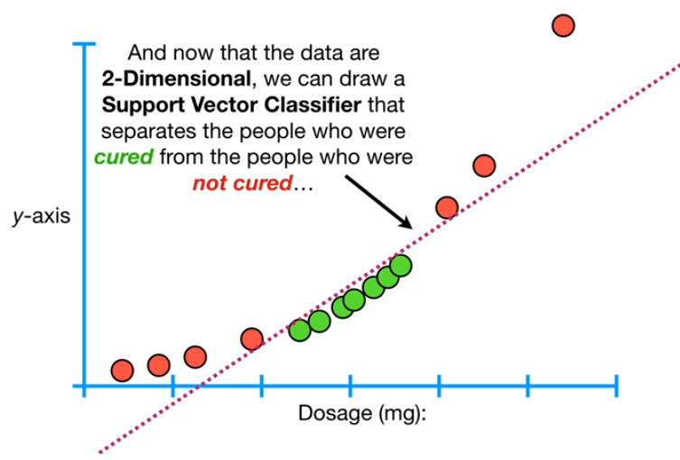
Nonlinear SVM
However, if we add another feature, dosage squares, then data points can now be separated by a line
This is the essential idea behind the Nonlinear SVM

Slide 37
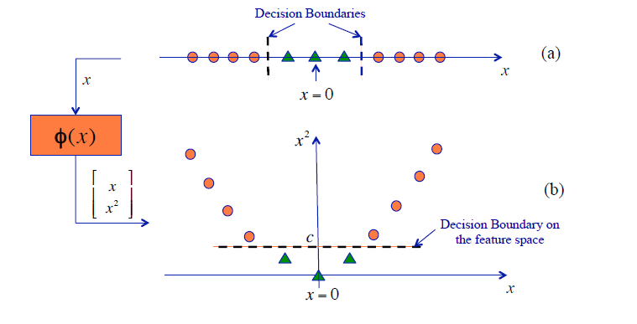
Nonlinear SVM:
Another illustration

Slide 38
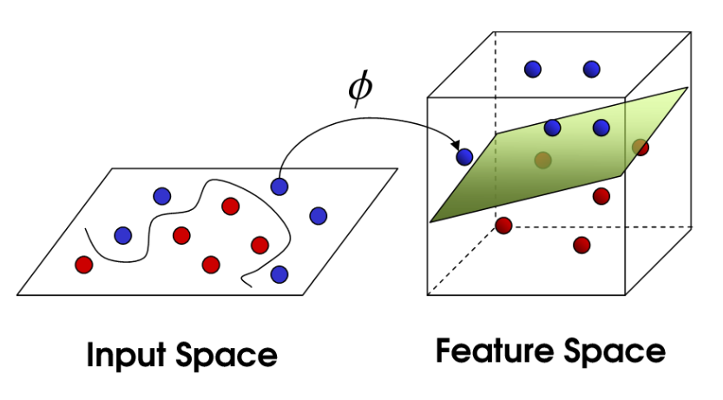
Nonlinear SVM: Idea
The original feature space can be mapped to some higher-dimensional feature space where the training set is separable

Slide 39
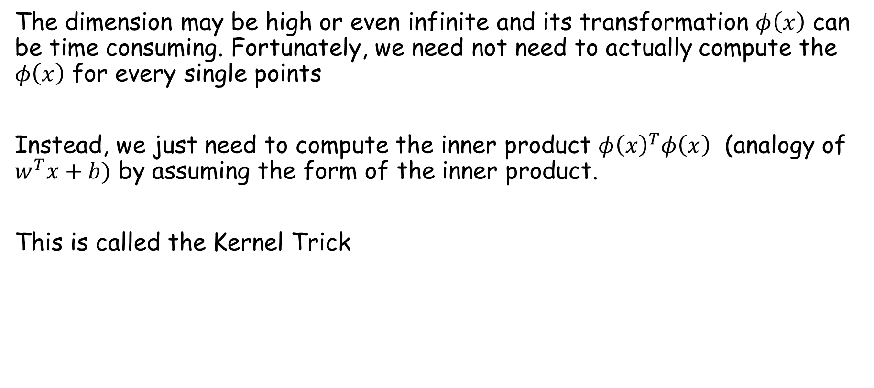
Kernel Trick
The dimension may be high or even infinite and its transformation $φ\left(x\right)$ can be time consuming. Fortunately, we need not need to actually compute the $φ\left(x\right)$ for every single points
Instead, we just need to compute the inner product $φ{\left(x\right)}^{T}φ\left(x\right)$ (analogy of $w^{T}x+b)$ by assuming the form of the inner product.
This is called the Kernel Trick

Slide 40
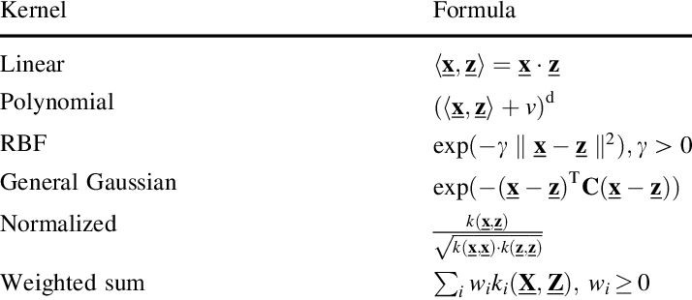
Common Kernels
More details in Appendix C

Slide 41
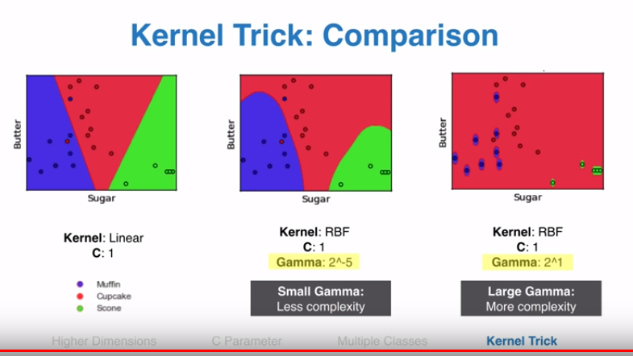
Nonlinear SVM in Practice
Need an additional Gamma parameter when using RBF Kernel
Large gamma: overfit, Low gamma: underfit

Slide 42
Learning by doing

Slide 43
Visualization of the Kernel Trick ideas
(110) SVM with polynomial kernel visualization - YouTube

Slide 44
Summary
Advantages:
Works well even when the number of features is much larger than the number of instances. Example in spam filter where a large number of words are the potential signifiers of a message being spam
Allows a non-linear decision boundary curve. SVM transforms the variables to create new dimensions such that the representation of the classifier is a linear function at higher dimensions
Disadvantages
No probability associated with each prediction
Training the SVMs can be time-consuming when data is large and there are lots of noise, hard to compute the soft margin

Slide 45
All Appendix are for the more mathematical oriented students and will not be tested in the exams

Slide 46
Appendix A

Slide 47
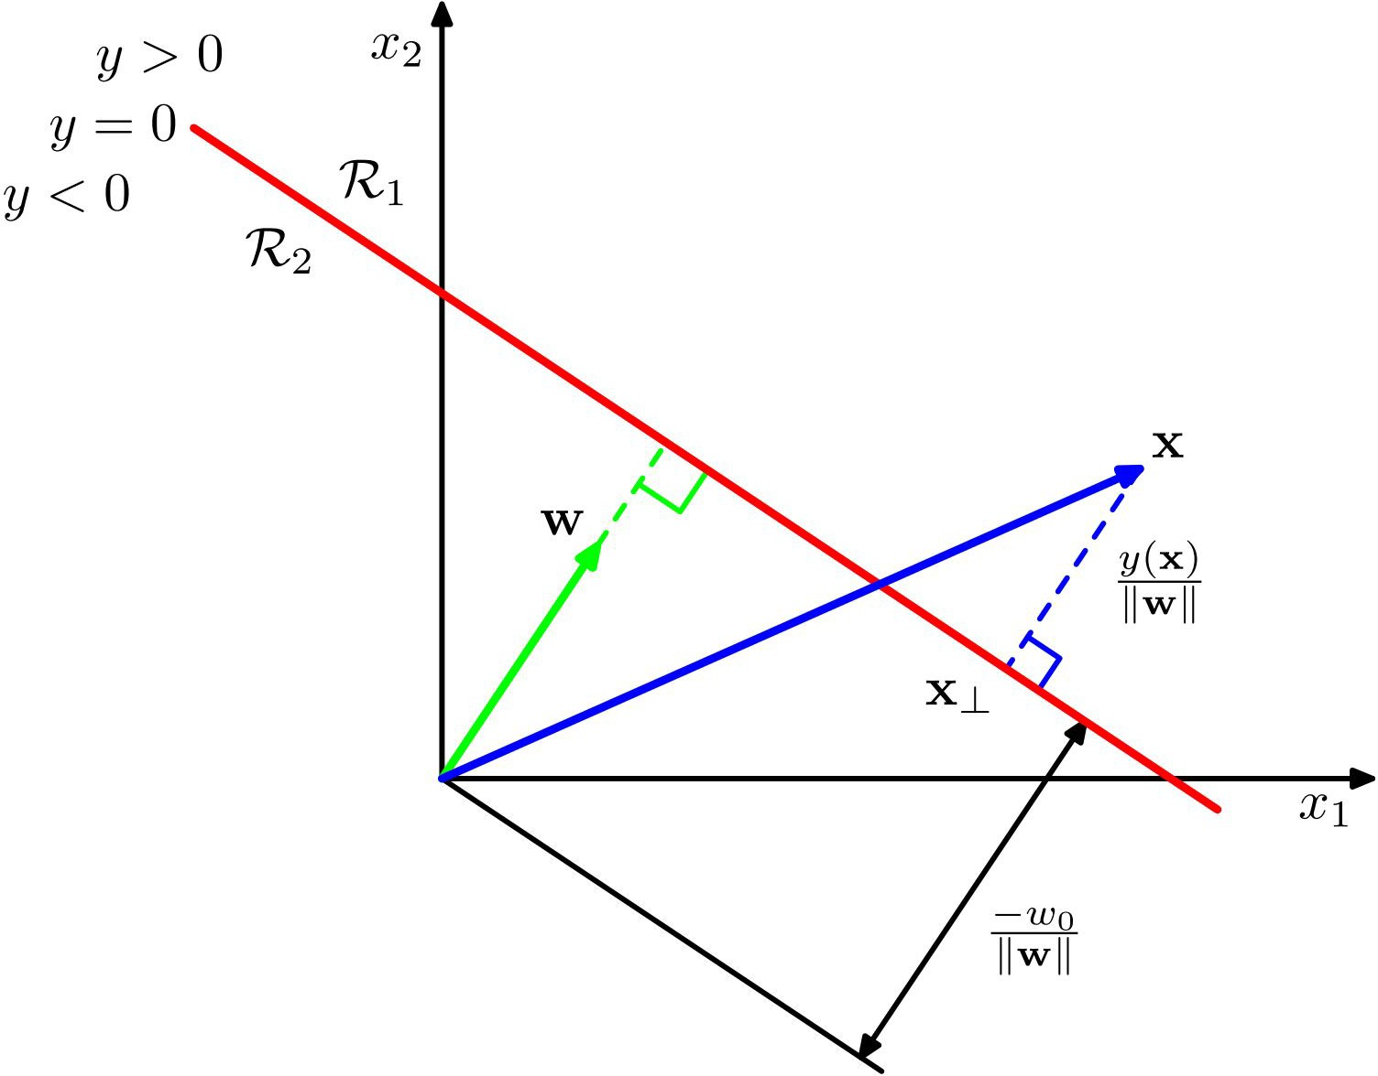
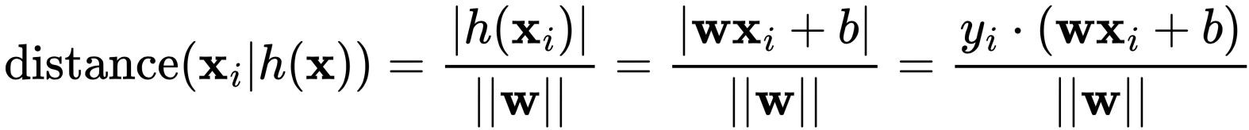
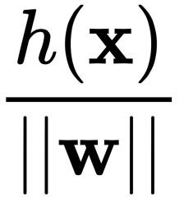
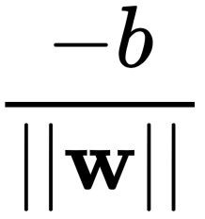
How to find the optimal Hyperplane
Basic knowledge:
❏ Separating hyperplane h(x): wx+b=0
❏ The distance of data point x_{i} to the separating hyperplane h(x):

Slide 48
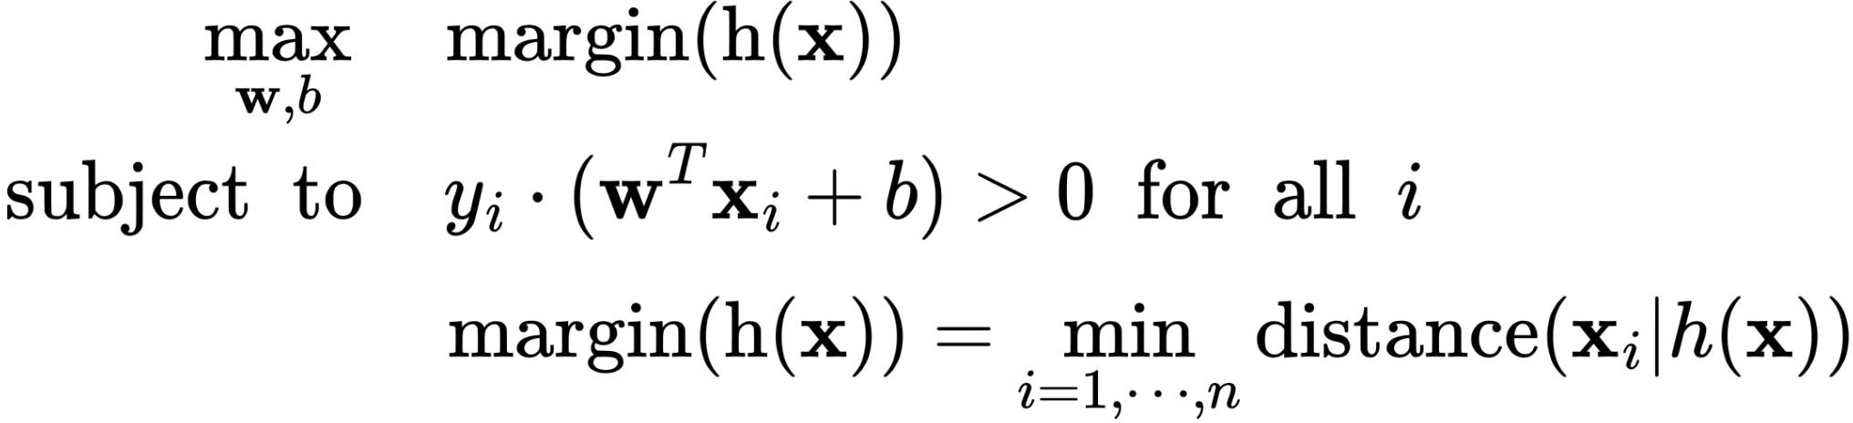
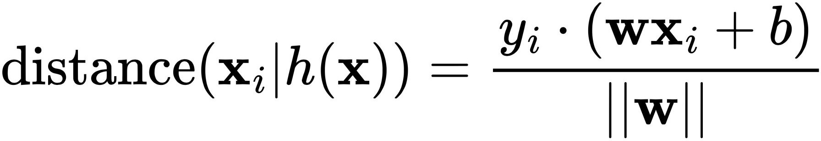
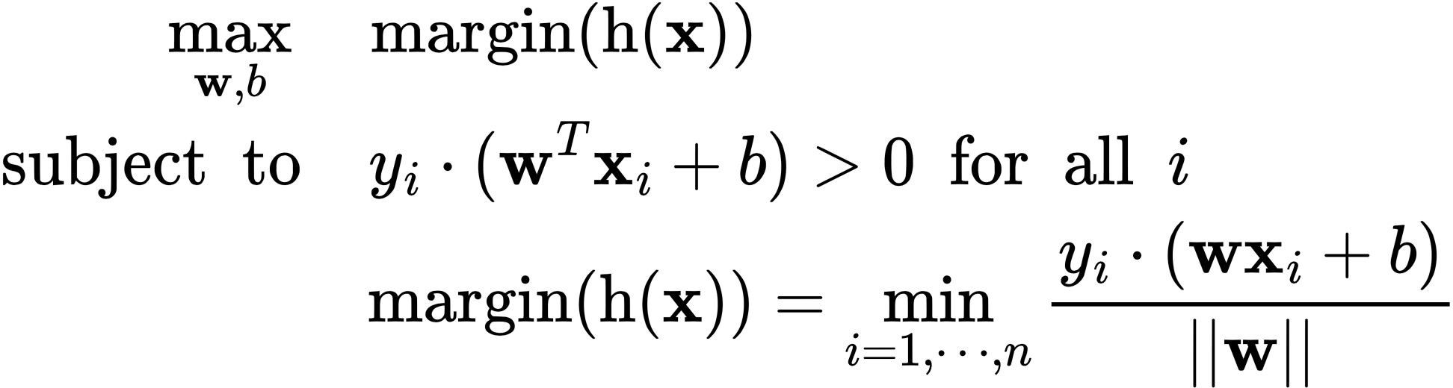
How to find the optimal Hyperplane
Intuitively, this is what we should solve:

Slide 49
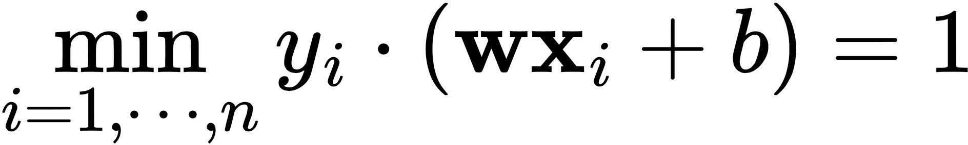
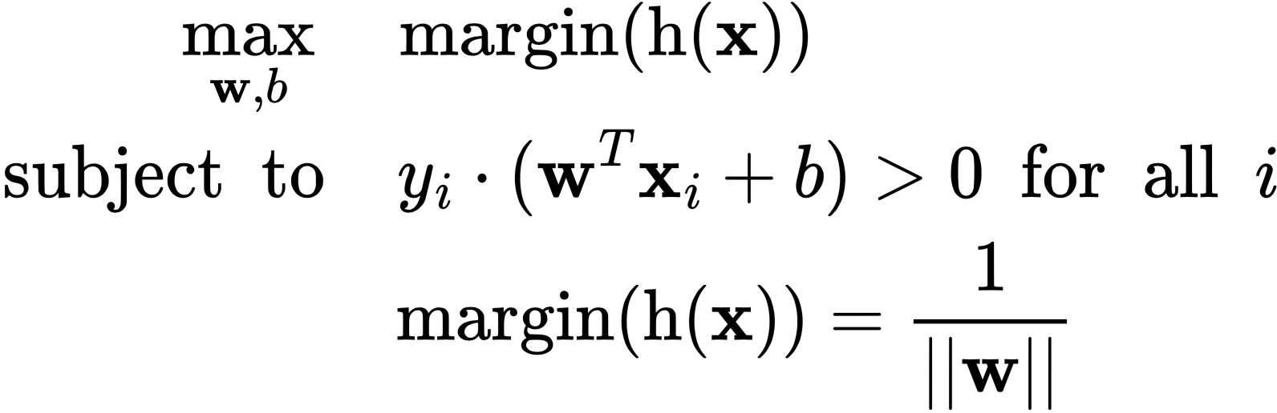
How to find the optimal Hyperplane
scaling the hyperplane parameters so that

Slide 50
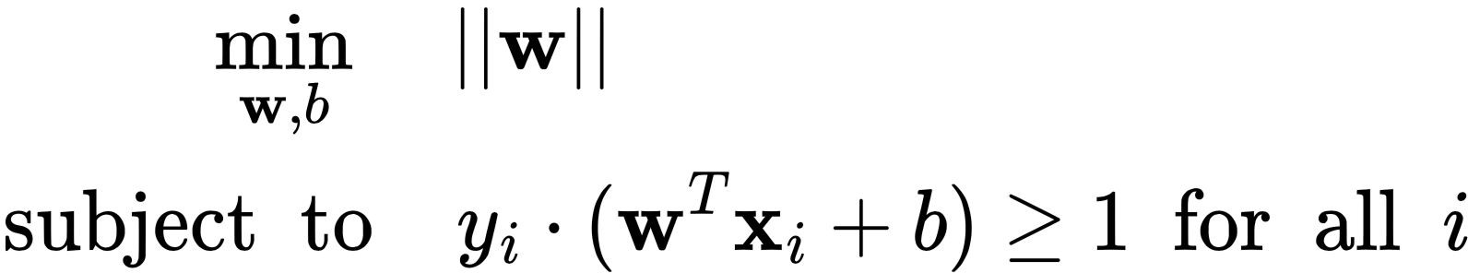
How to find the optimal Hyperplane

Slide 51
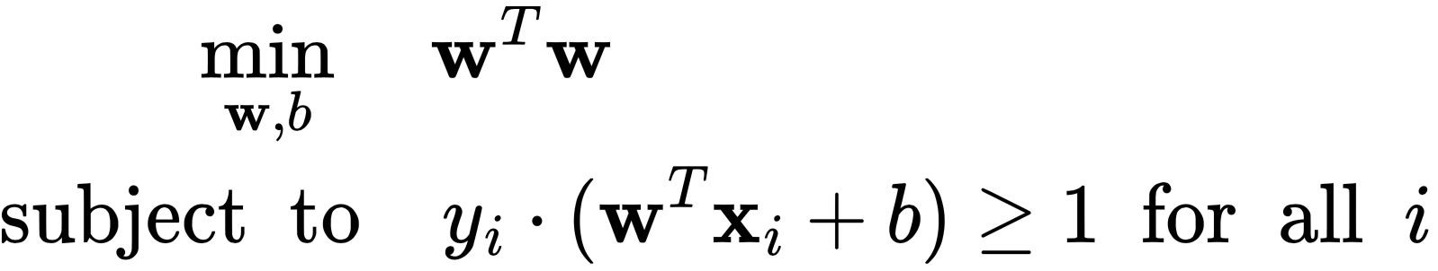

How to find the optimal Hyperplane
The simplest format of a constrained optimization problem (quadratic programming), can be solved efficiently.

Slide 52
Appendix B
Details on non-separable Linear SVM

Slide 53
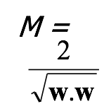
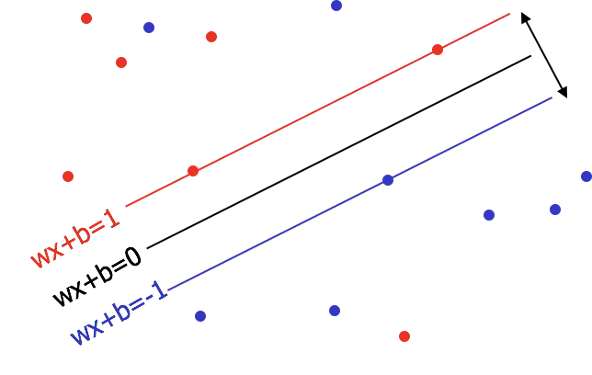
Linear SVM for Non-separable Data
Minimize: w^{T}w + C (distance of error points to their correct place)

Slide 54
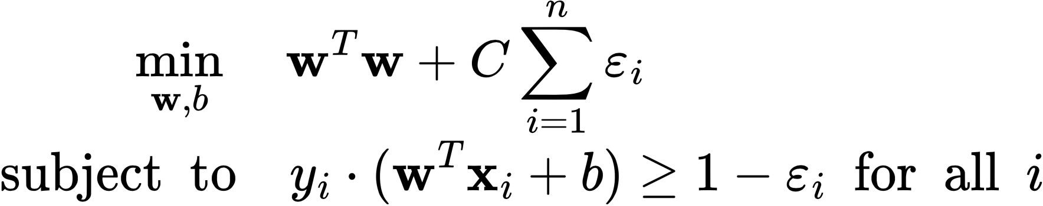
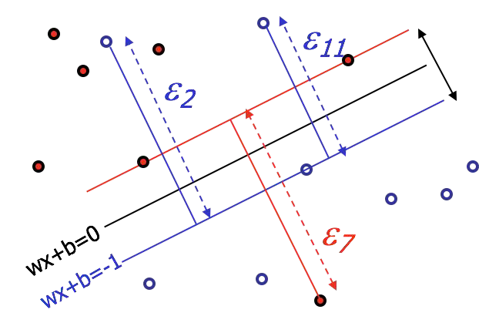
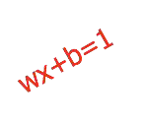
Linear SVM for Non-separable Data

Slide 55
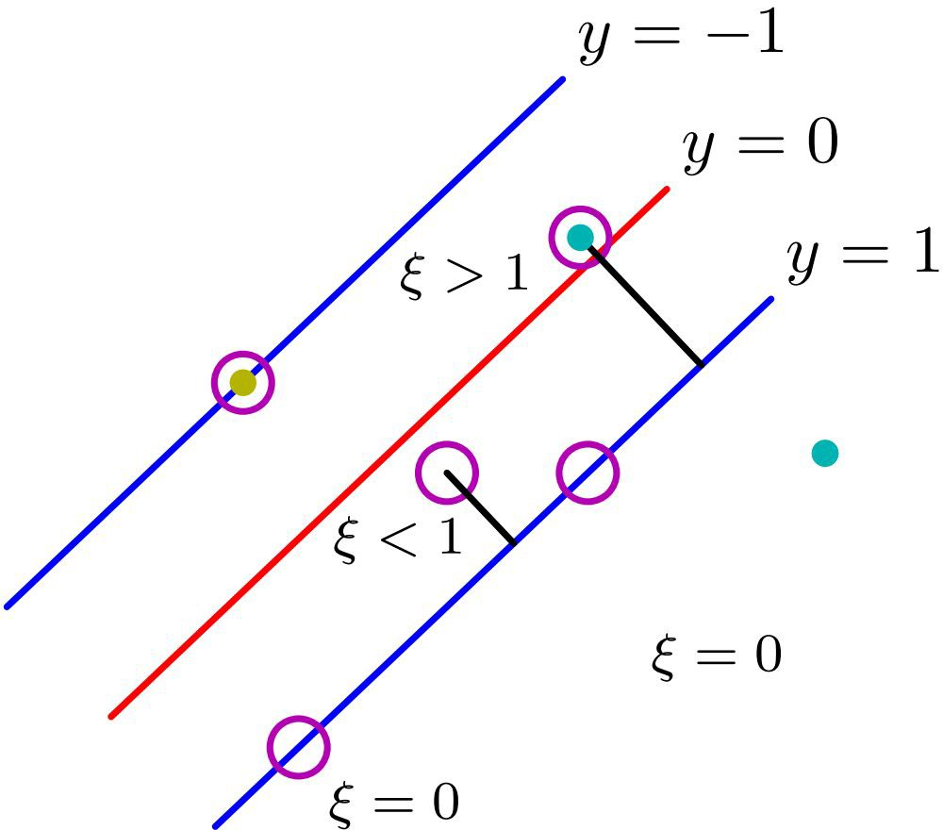
Linear SVM for Non-separable Data
❏ ε_{i}=0: data points correctly classified (either on the margin or on the correct side of the margin)
❏ 0<ε_{i}<=1: lie inside the margin, but on the correct side of the decision boundary
❏ ε_{i}>1: wrong side of the decision boundary and are misclassified

Slide 56
Appendix C
Details on Kernel Trick

Slide 57
A Quick Example for Kernel
❏ Simple Example: x = (x₁, x₂, x₃); y = (y₁, y₂, y₃). Then for the function ɸ(x) = (x₁x₁, x₁x₂, x₁x₃, x₂x₁, x₂x₂, x₂x₃, x₃x₁, x₃x₂, x₃x₃), the kernel is
K(x, y ) = (<x, y>)².
❏ Suppose x = (1, 2, 3); y = (4, 5, 6).
❏ Transform then inner product:
ɸ(x) = (1, 2, 3, 2, 4, 6, 3, 6, 9),
ɸ(y) = (16, 20, 24, 20, 25, 30, 24, 30, 36)
<ɸ(x), ɸ(y)> = 16 + 40 + 72 + 40 + 100+ 180 + 72 + 180 + 324 = 1024
These two computation steps can be quite expensive
❏ Use Kernel:
K(x, y) = (4 + 10 + 18 )² = 32² = 1024
Same result, but this calculation is so much easier.

Slide 58


A Quick Example for Kernel
❏ Simple Example: x = (x₁, x₂, x₃); y = (y₁, y₂, y₃). Then for the function ɸ(x) = (x₁x₁, x x , x x , x x , x x , x x , x x , x x , x x ), the kernel is
K(x,
❏ Sup
❏ T
1 2 1 3 2 1 2 2 2 3 3 1 3 2 3 3
y ) = (<x, y>)².
pose x = (1, 2, 3); y = (4, 5, 6).
ransform then inner product:
i) ɸ(x) = (1, 2, 3, 2, 4, 6, 3, 6, 9),
ɸ(y) = (16, 20, 24, 20, 25, 30, 24, 30, 36)
ii) <ɸ(x), ɸ(y)> = 16 + 40 + 72 + 40 + 100+ 180 + 72 + 180 + 324 = 1
hese two computation steps can be quite expensive
se Kernel:
(
In terms of result,
Kernel = Feature Transformation + Inner Product
(
024
T
❏ U
K(x, y) = (4 + 10 + 18 )² = 32² = 1024
Same result, but this calculation is so much easier.

Slide 59
The “Kernel Trick”
❏ Note: SVMs rely on the inner product between vectors
T
K(x_{i},x_{j})=x_{i} x_{j}
❏ If every data point is mapped into high-dimensional space via some transformation Φ:x → Φ(x), the inner product
T
becomes: K(x_{i},x_{j})= Φ(x_{i}) Φ(x_{j})
❏ A kernel function is a type of function that is equivalent to an inner product in some feature space.

Slide 60
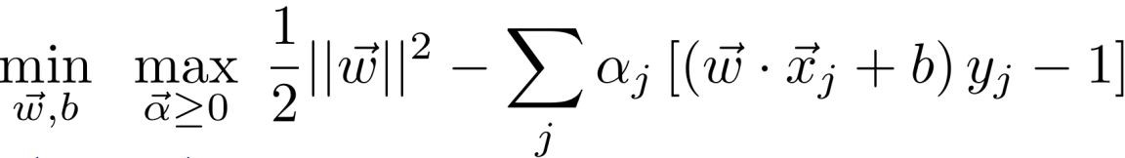
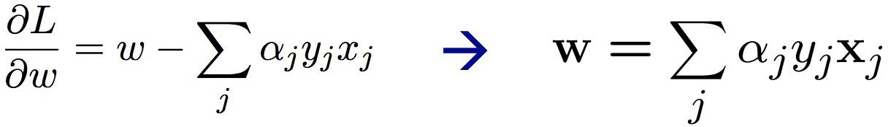
How kernel helps SVM
SVM originally wants to optimize:
Bring another data-point
wise parameter ⍺:
L=
The relation between w and ⍺:

Slide 61
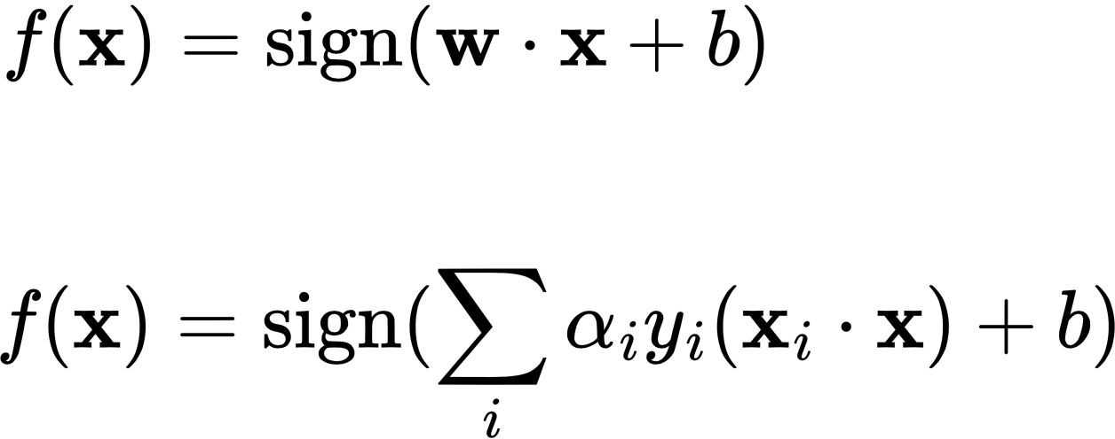
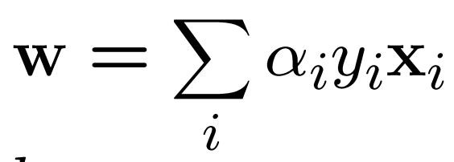
How kernel helps SVM

Slide 62
How kernel helps SVM
Note that SVM classifier can be written in a form of inner product

Slide 63
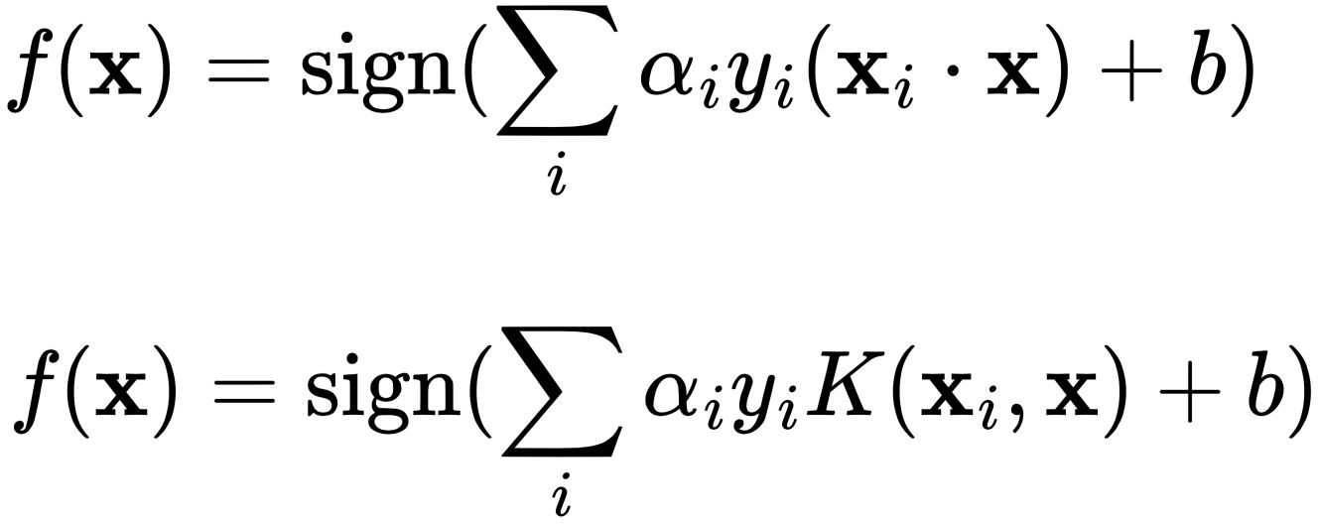
How kernel helps SVM
replace the original inner product with kernel

Slide 64
How kernel helps SVM
Both function mean: SVM predicts the label of the new example x_{i} by a weighted combination of labels of all training examples; the weights are determined by the kernel and ⍺i.

